Slide 1

Psychological Disorders
Chapter 15

Slide 2
Announcements
Quiz 9 (due 11/8)
Research (go do the thing!) Due by 5:00pm 11/28!
  https://msutexas.edu/academics/libarts/psychology/undergraduate-research.php

Slide 3

Abnormal Psychology
Study of human behavior that is atypical of one’s culture and society
Clinical focus
  Rehabilitation of individuals to improve functioning and well being
    Clinical Psychology
    Counseling Psychology

Slide 4
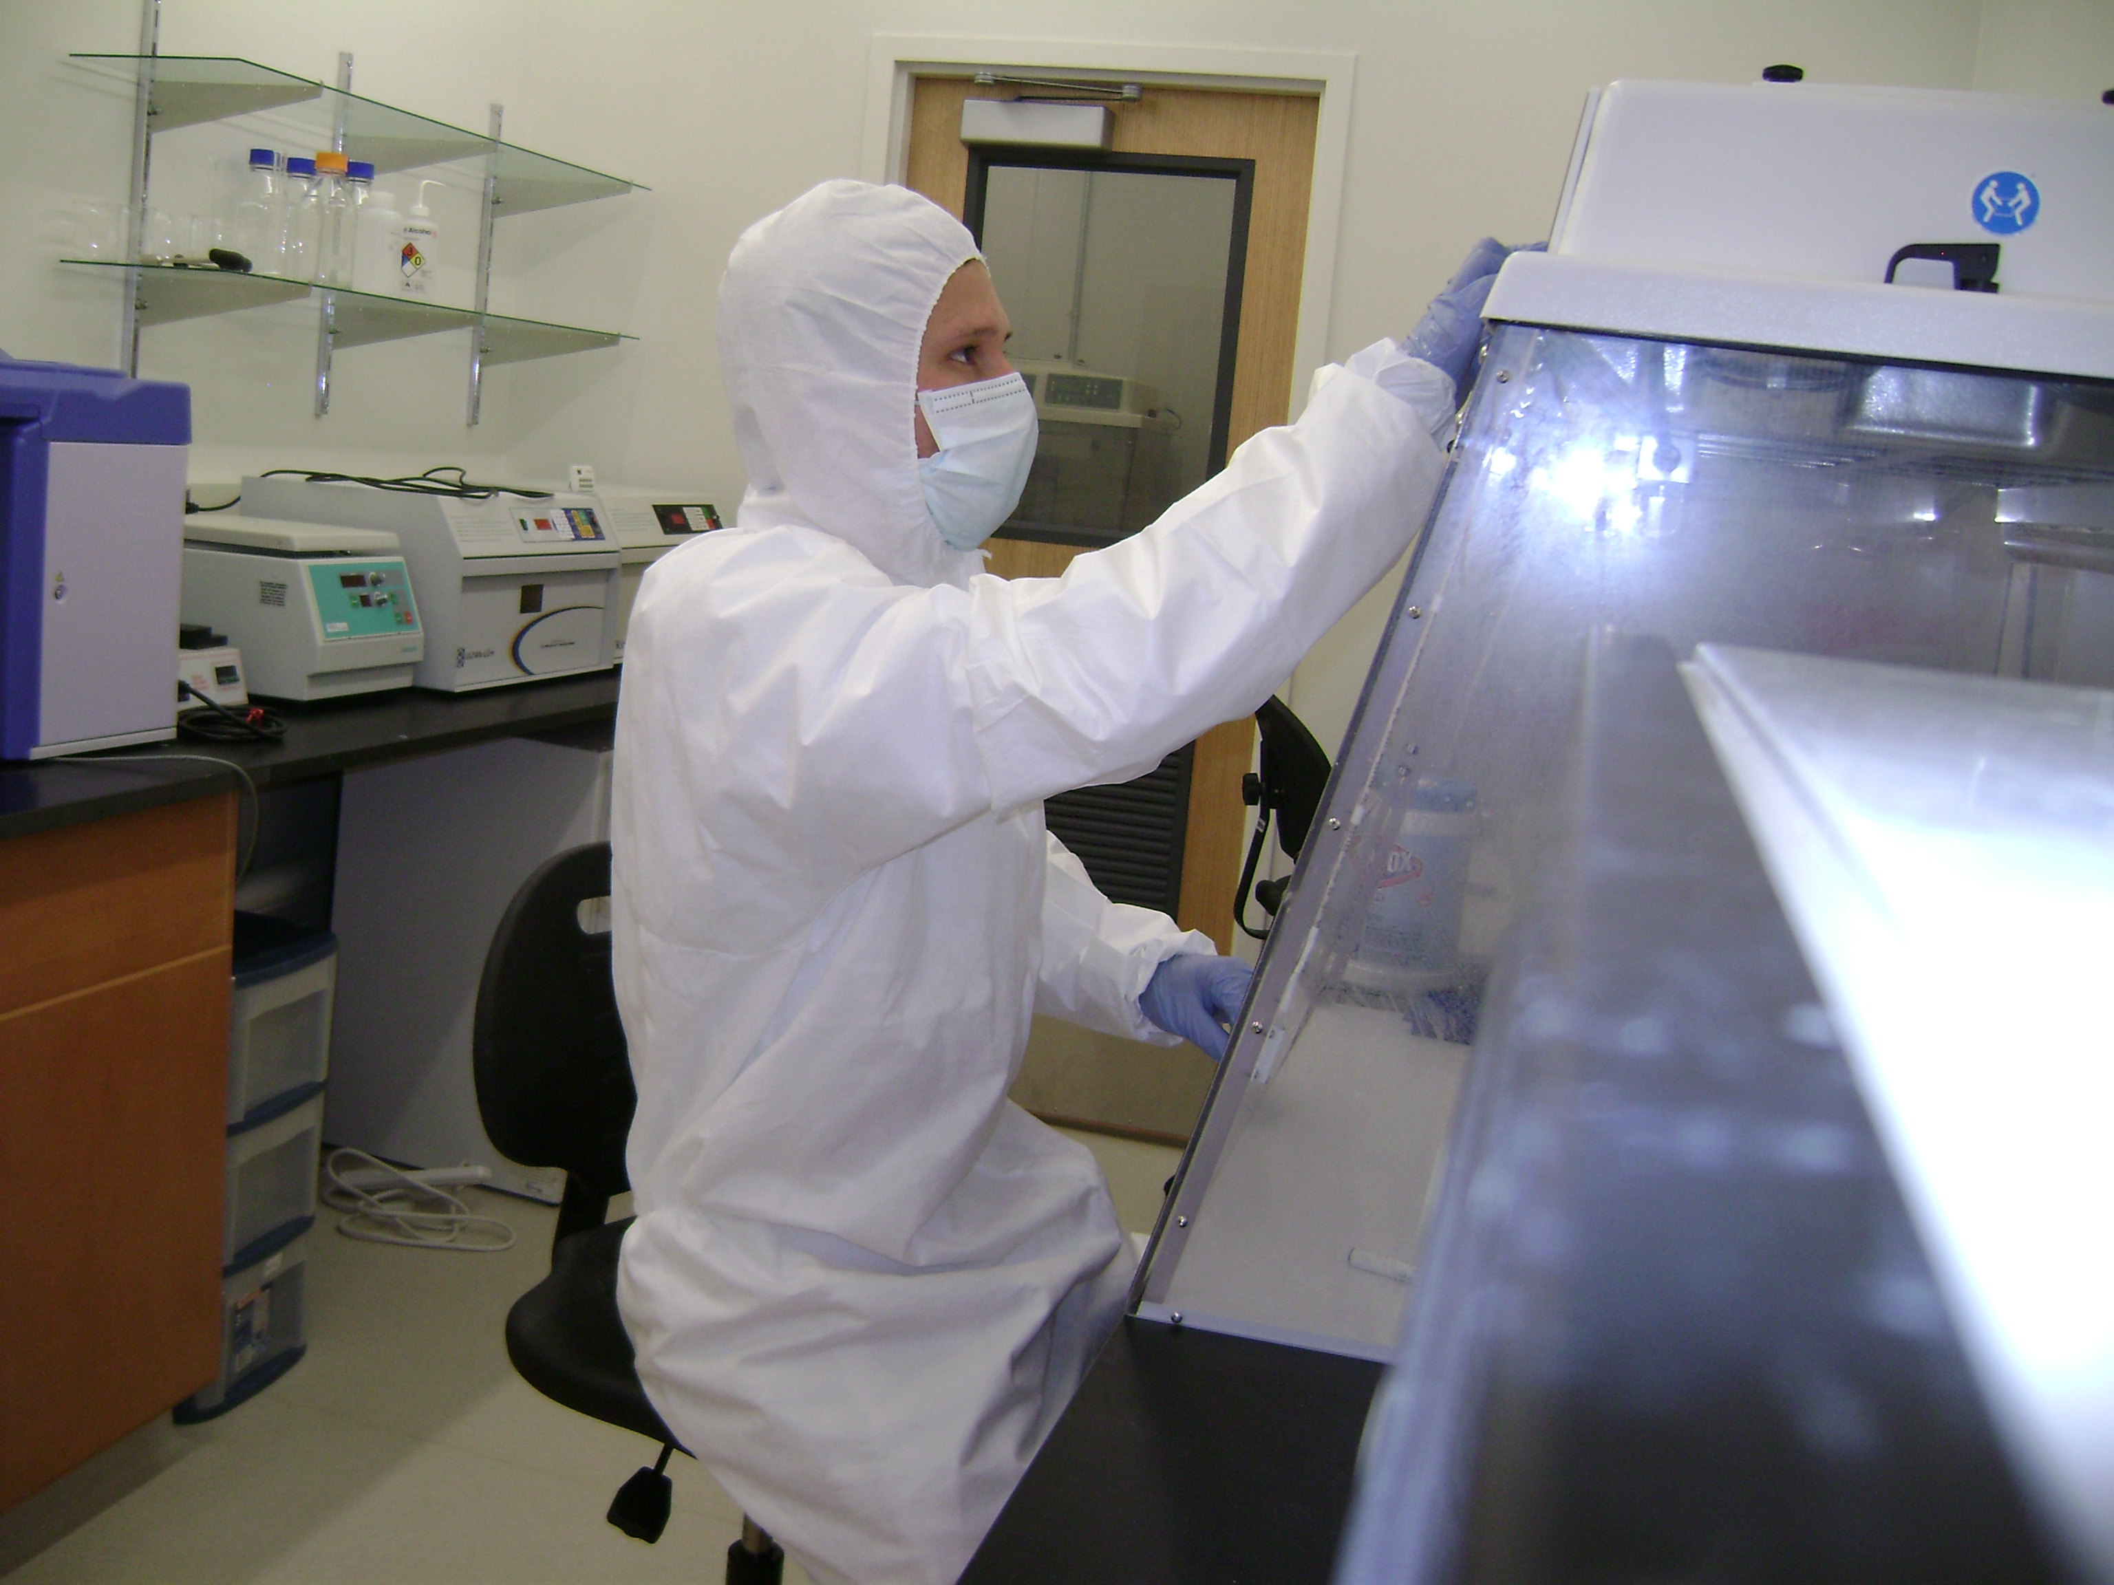

What is a psychological disorder?
Abnormal behavior: Deviant, maladaptive, or personally distressing over a long period of time

Slide 5
What is a psychological disorder?
Deviant: Violates social norms and expectations
Maladaptive: Interferes with a person’s ability to function effectively in daily life
Personally distressing: The person engaging in the behavior finds it unpleasant/wants to stop

Slide 6
What is a psychological disorder?
Social acceptability and the oppressive use of “disorder”
Drapetomania (a mental disorder in which slaves fled from slavery; Cartwright, 1851)
Homosexuality (until 1973)
Hysteria

Slide 7
What is a psychological disorder?
Where does disorder come from?
  1) Biological approach: A medical model that views psychological disorder as essentially the same as biological illness
  2) Psychological Approach: Sees experience, thought, emotion, and/or personality as causes of mental disorder

Slide 8
What is a psychological disorder?
Where does disorder come from?
  3) Sociocultural perspective: Because social norms define disorder, some disorders are the result of a cultural setting
  Example: Anorexia (almost exclusively occurs in Western cultures)

Slide 9
What is a psychological disorder?
Biopsychosocial model is used to understand the many factors contributing to psychological disorders

Slide 10
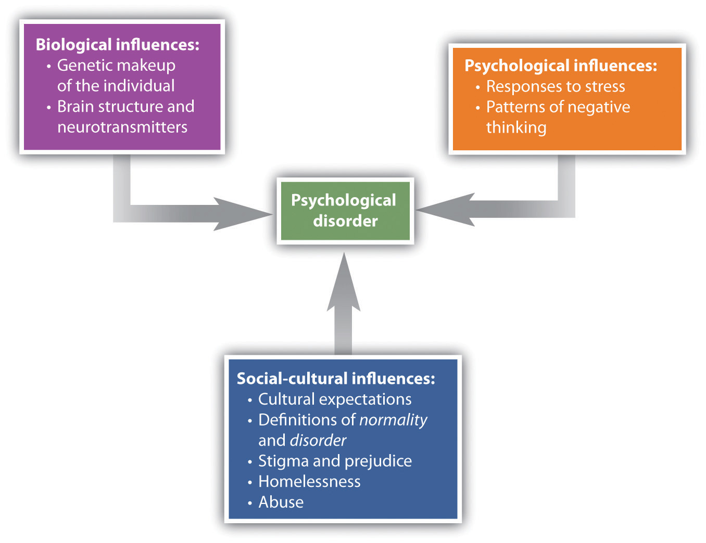

Slide 11
The “4 D’s” of Abnormality
Deviance
  Thoughts, behaviors, and/or emotions that are unacceptable in society
Distress
  Feeling despair
Dysfunction
  Impairment of an individual’s ability to perform daily function
Danger
  Behavior that could jeopardize safety or physical/psychological well being of others

Slide 12
The “4 D’s” of Abnormality
Must disrupt functioning of an individual on a daily basis
  Possess one or more of the Ds
So what do the 4 Ds tell us???
  The VAST majority of people (including you!) do not struggle with a psychological disorder!
  If you do, they can be treated!

Slide 13
First… Some Cautions
Gaining knowledge of psychological disorders…
  DOES NOT allow you to diagnose yourself with a psychological disorder
  DOES NOT allow you to diagnose/label others around you with a psychological disorder
  DOES NOT allow you to attempt to treat someone who does have a psychological disorder (i.e., play therapist)
  DOES allow you to gain some knowledge/perspective of the struggles of others
  DOES allow you to learn about the importance of mental health

Slide 14
Diathesis-Stress Model
Clinical psychologists use a diathesis-stress model of disorders
  Diathesis
    Underlying predisposition to a mental disorder
  Stress
    A trigger that could increase the probability of a mental disorder

Slide 15
Diathesis-Stress Model
Low
Vulnerability
Amount of Stress
High
Vulnerability
Amount of
Stressor
Time

Slide 16
Vulnerability-Stress Hypothesis
Everyone differs to their susceptibility to mental illness based on:
  Daily stressors
  Personality factors
  Environmental changes (e.g., family death, breakup, etc.)
  Physical health
  Age

Slide 17
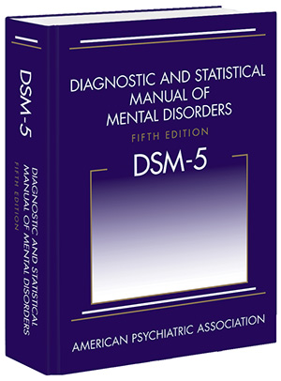
Classifying Abnormal Behavior
Classifying abnormal behavior: The Diagnostic and Statistical Manual (DSM)

Slide 18
Classifying Abnormal Behavior
The DSM is NOT the only classification system!
However, it is the primary manual used in the US
Current version: DSM-V (5)

Slide 19
DSM-V Classification System
Advantages
  Common definitions, agreed upon by clinicians
  Quantification of disorders
  Naming disorder provides comfort through knowledge of what symptoms/outcomes to expect
  Knowledge of how a disorder operates can lead to treatment
Disadvantages
  Naming can lead to stigma, labels (shame, negativity)
  Medical terminology implies internal cause (neglects experiential/psychological causes

Slide 20
Other Disadvantages of the DSM
1) Curated heavily by psychiatrists, who tend to use a biological model
2) Relies on vague or loose criteria

Slide 21
Neurodegenerative Disorders:
Autism Spectrum Disorder
Persistent deficits in social interaction and communication
Engagement in restrictive repetitive behaviors
Diagnosed in children, thought to produce lifelong impairment
  1:69 diagnosed
  Spectrum: Highly variable symptom severity
  More common in boys

Slide 22
Neurogenerative Disorders:
Attention-Deficit/Hyperactivity Disorder
Inattention, hyperactivity, impulsivity
  2/3rds persist to adulthood
  Medication (stimulants) and therapy are effective treatments
  Deficit of cognition/executive function
  Symptoms improve as children age
Very commonly diagnosed in children
  Over-diagnosed?
  Diagnoses increased 2000% from 1988 to 2010 (10.4 million diagnosed in 2010)
  Why?
  Is “normal” childhood behavior considered psychopathology?

Slide 23
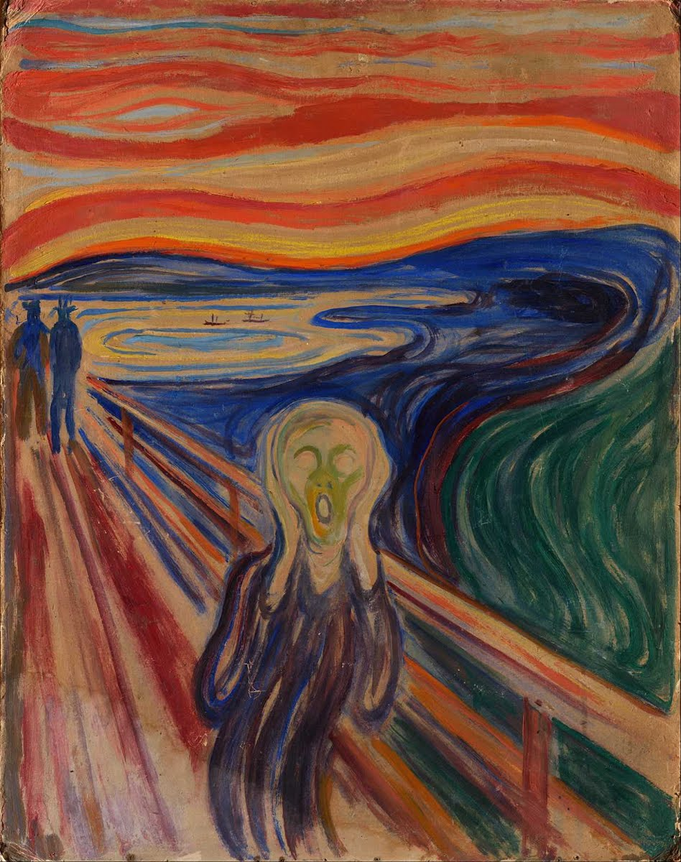
Anxiety/Anxiety-Related Disorders
Uncontrollable fears that are disproportionate and disruptive to daily functioning
Generalized Anxiety Disorder (GAD)
Panic Disorder
Specific Phobia
Social Anxiety Disorder
Anxiety-related disorders
  Obsessive-compulsive disorder
  Post-traumatic stress disorder

Slide 24
Generalized Anxiety Disorder (GAD)
Symptoms
  Persistent anxiety for at least 6 months
  Suffer: Fatigue, muscle tension, stomach problems, insomnia
Etiology (causes)
  Biological Factors
    Genetic factors, GABA deficiency, respiration
  Psychological/Sociocultural Factors
    Harsh self-standards, critical parents, constant negative thoughts, trauma

Slide 25
Generalized Anxiety Disorder (GAD)
Must also have detrimental effects on a person’s well-being
In GAD, there is no one specific problem that is the focus of anxiety
GAD has high comorbidity with depression, so anti-depressants are a common treatment)

Slide 26
What Causes GAD?
1) Cognitive explanation: Worry about a target (e.g., money) is compounded with worrying ABOUT worrying (Wells, 1995)
2) Genetic explanation: GAD tends to run in families. Genetic factors can explain 37.9% of the prevalence of GAD (Scherrer et al., 2000)
3) Biological causes: Problems in the production of GABA, a primary inhibitory neurotransmitter (Boschen, 2012)

Slide 27
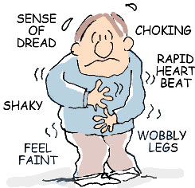
Panic Disorder
Symptoms
  Recurrent, sudden onset of intense terror that often occurs without warning
  NO SPECIFIC CAUSE
  Panic Attacks are persistent
Etiology (Causes)
  Biological Factors
    Genetic Predisposition
    Norepinephrine, GABA, and Serotonin
    Hormone regulation in response to stress
  Sociocultural Factors
    Women > Men

Slide 28
Panic Disorder vs. GAD
Generalized Anxiety Disorder (GAD) = long-term anxiety
Panic Disorder = short, intense bursts of anxiety

Slide 29
What Causes Panic Disorder?
1) Conditioning theory: Neutral stimuli are paired with a panic attack, then anxiety about those stimuli in future situations induces panic (Wolpe & Rowan, 1988)
2) Substance use: Drug/alcohol abuse common precursors of PD. ~40% of people with PD previously had problems with addiction to drugs or alcohol (Katerndahl & Realini, 1999)
3) Biological causes: Lactates (a supplemental source of energy) are elevated for individuals with panic disorder (Maddock et al., 2009)

Slide 30
Anxiety Disorders
Phobias: Specific fears of a certain target
Phobia | Target
Arachnophobia | Spiders
Chromophobia | Colors
Social Phobia | Social interaction
Claustrophobia | Small spaces
Agoraphobia | Crowds, other spaces in which escape is difficult
Acrophobia | Heights

Slide 31
Phobias
Phobias vs. Fear
To classify as a phobia, an individual must a) almost always respond to the target with fear, b) feel that the persistent fear is excessive or unreasonable

Slide 32

Agoraphobia
Phobia related to being in a public place where escape is difficult
  Occurs both with and without panic attacks
  Panic attacks occur randomly, therefore they are unpredictable
Individuals often withdraw from society
  Avoid public places
  Avoid travel
200,000 new cases in the US/year (fairly common)

Slide 33
Specific Phobia
Symptoms
  Irrational, overwhelming fear of a particular object or situation that is excessive and unreasonable
  Exposure to stimulus immediately provokes response
Etiology
  Biological Factors
    Genetic predisposition
  Psychological Factors
    Learned from previous experience, typically before the mid 20’s

Slide 34
Social Anxiety Disorder
Symptoms
  Intense fear of being humiliated and/or embarrassed in social situations
Etiology
  Biological Factors
    Genetic disposition
    Neural circuitry (amygdala shows heightened reactivity)
    High levels of serotonin
  Psychological Factors
    Over-protective/Rejecting parenting
    Negative learned social experiences

Slide 35
Obsessive-Compulsive Disorder (OCD)
Symptoms
  Persistent anxiety-provoking thoughts and/or urges
  Obsessions – Recurrent thoughts
  Compulsions – Recurrent actions
Etiology
  Biological Factors
    Genetic predispositions
    Neurotransmitters
  Psychological Factors
    Avoidance learning

Slide 36
Obsessive-Compulsive Disorder (OCD)
Obsessions are recurrent and cause anxiety.
To qualify for OCD:
  A person must realize that obsessions are irrational or a product of their mind, but that they cannot be controlled (Abramowitz, Taylor, & McKay, 2009)

Slide 37
Obsessive-Compulsive Disorder (OCD)
Compulsions are rituals designed to alleviate the anxiety of the obsession
Example: obsessive fears about the future may cause people to compulsively buy things, acquire free items, or hang on to old items (hoarding; Frost & Steketee, 2011)

Slide 38
Causes of OCD
1) Biological: Reduced serotonin and dopamine
2) Psychological: OCD is associated with selective learning of negative outcomes

Slide 39
Post-Traumatic Stress Disorder (PTSD)
Symptoms
  Exposure to previous traumatic experience, oppressive situation, natural or unnatural disaster
  Active reliving of the trauma (flashbacks)
  Types
    Acute: 3 months or less
    Chronic: Greater than 3 months
    Delayed onset: Symptoms appear 6 months after the event
  Affects 10-20% of military veterans
Etiology
  Biological Factors
    Genetic predisposition
  Development is primarily psychological

Slide 40
Post-Traumatic Stress Disorder (PTSD)
Not everyone who experiences a traumatic event develops PTSD: estimates are usually below 25%
One factor that increases the risk of PTSD is the nature of trauma
  Rape, sexual abuse, and personal assault all showing higher rates than serious accidents (Hapke et al., 2006)

Slide 41
Mood-Related Disorders
Disturbance of mood that affects one’s emotional state
Symptoms may include:
  Cognitive, behavioral, or physical symptoms
  Interpersonal difficulties
Comorbid with anxiety disorders

Slide 42
Major Depressive Disorder
Symptoms
  Significant depressive episode that lasts for at least 2 weeks
  Daily functioning is impaired
  Fatigue, sense of worthlessness, reduced interest, sleep disturbance, appetite suppression
Not in response to negative life events (e.g., bereavement)

Slide 43
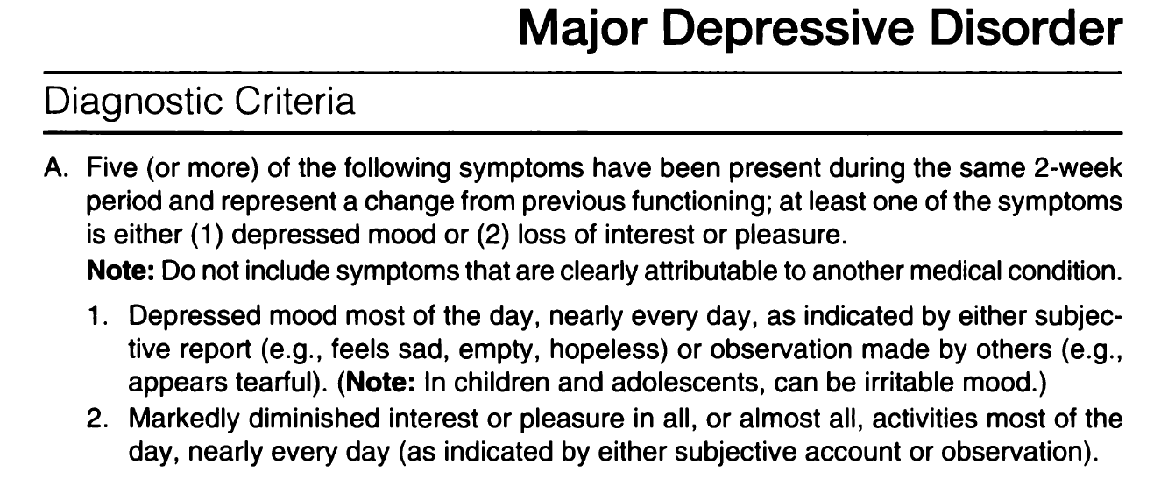
Major Depressive Disorder:
DSM-V Diagnostic Criteria

Slide 44
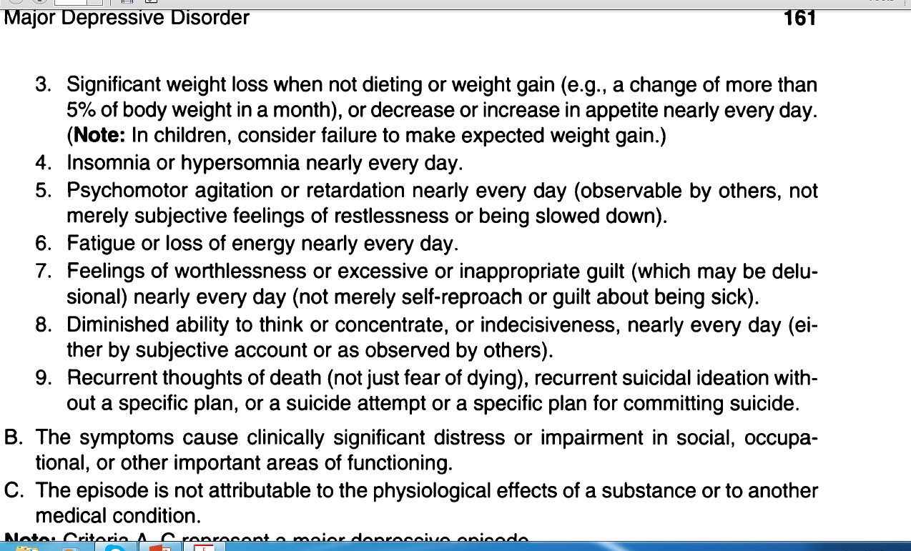
Major Depressive Disorder:
DSM-V Diagnostic Criteria

Slide 45
Major Depressive Disorder
Etiology
  Biological Factors
    Genetic Disposition
    Underactive prefrontal cortex
    Neurotransmitters (Serotonin, MAO)
  Psychological Factors
    Learned helplessness
    Ruminating on negativity
    Pessimism
  Sociocultural Factors
    Poverty
    Low SES
    Women > Men

Slide 46
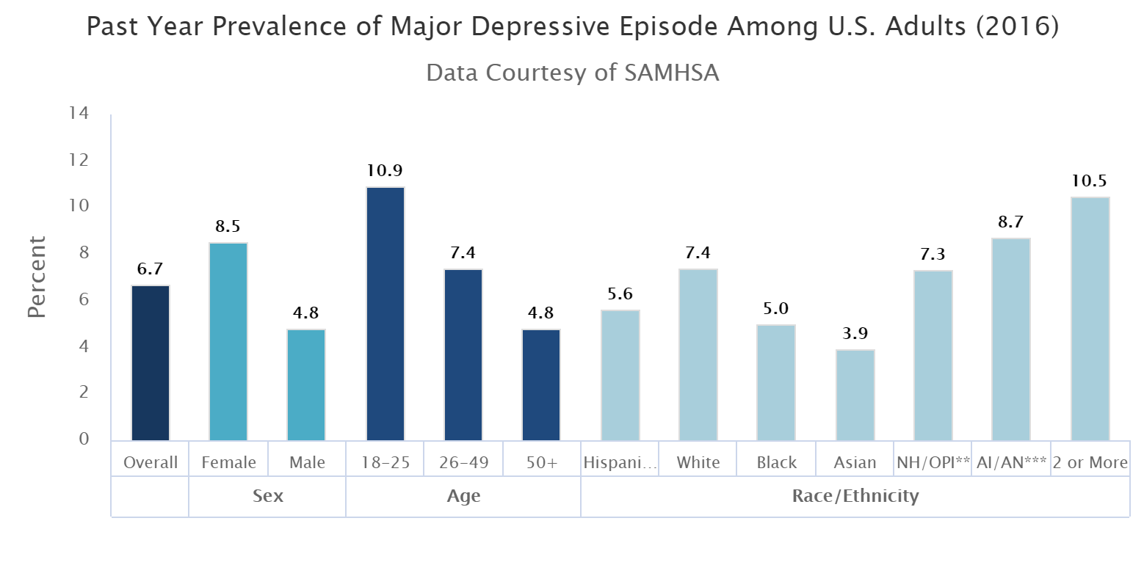
Depression

Slide 47
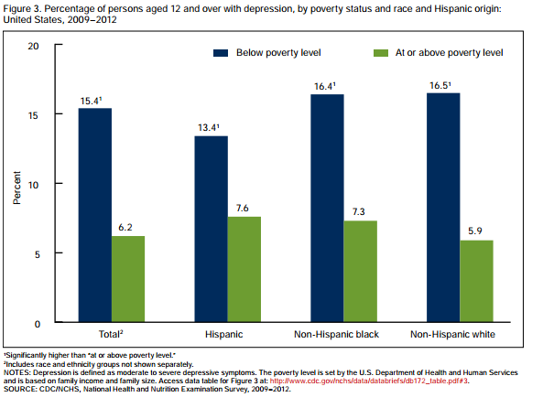
Depression

Slide 48
Depression
There is evidence for a genetic component to depression (Caspi et al., 2003)
Specifically, individuals with two short alleles of the 5-HTT gene (involved in the production of serotonin) are far more likely to develop depression

Slide 49


Depression
Psychological causes of depression have been noted as well
In particular, depressed individuals take to make global, internal, and stable attributions for negative events (Sanjuan, Arranz, & Castro, 2013)

Slide 50
Bipolar Disorder
Bipolar disorder is characterized by both intense bouts of negative mood (like depression) but also corresponding experiences of extreme excitement and energy (manic states)

Slide 51
Bipolar Disorder
Bipolar 1 Disorder
  Characterized by extreme mood swings that include mania
  Mania – Extremely overexcited, unrealistically optimistic state

Slide 52
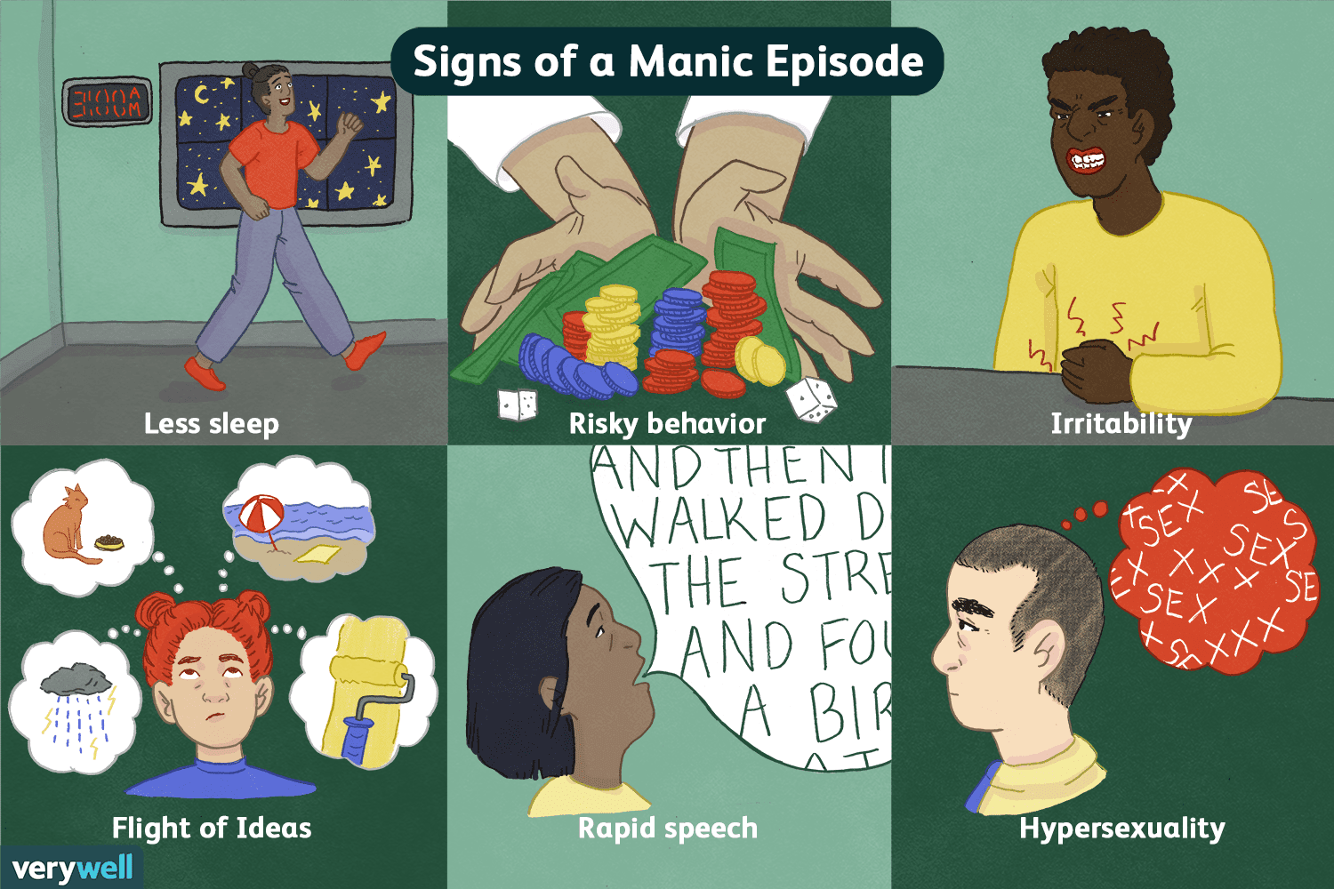

Slide 53
Bipolar Disorder
Bipolar 2 Disorder
  Similar to BPD1, but without the mania
Frequency and separation of episodes
  Rapid cycling
  Seasonal onset
  Longitudinal (episodes separated by 6 months to a year)

Slide 54
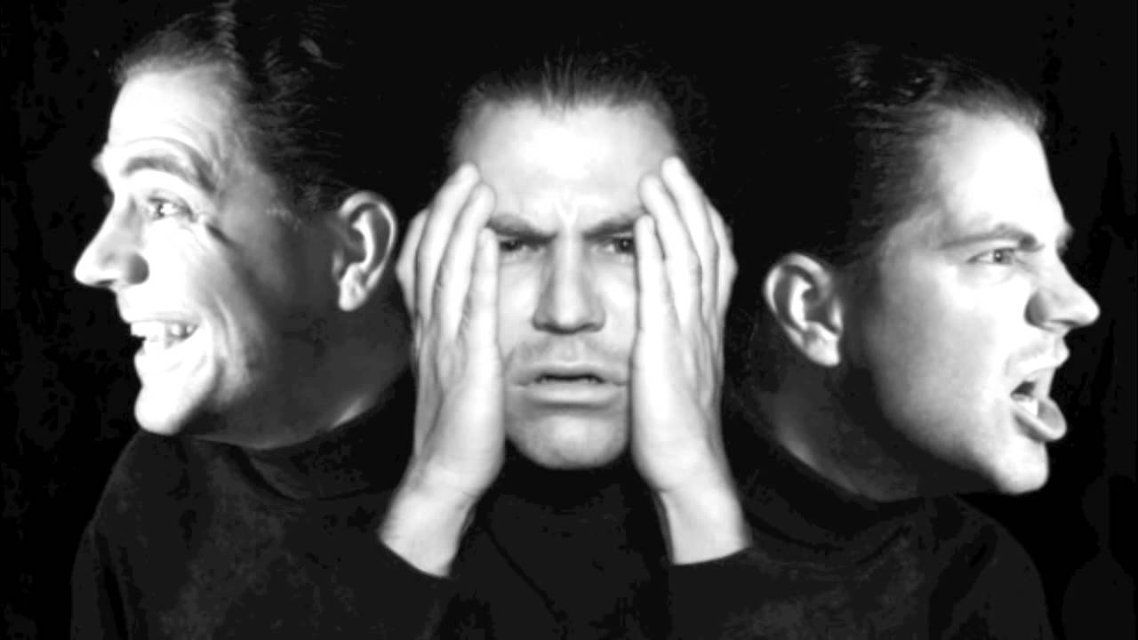
Bipolar Disorder
Etiology
  Strong genetic component
  Swings in metabolic activity within the cerebral cortex
  Deficiencies in neurotransmitter levels

Slide 55
Bipolar Disorder
Bipolar 1 vs. Bipolar 2
Bipolar 1 involves manic states that are so intense they often include delusional beliefs or hallucinations
Bipolar 2 only involves the elevated mood (but no hallucinations or delusions)

Slide 56
Dissociative Disorders
Dissociative disorders are marked by a disruption of memory, awareness, and identity
It has long been believed that dissociation is the result of trauma (e.g., Breuer & Freud, 1895)
Individuals who experienced childhood sexual trauma are more likely to develop dissociative symptoms (Chu & Dill, 1990)

Slide 57
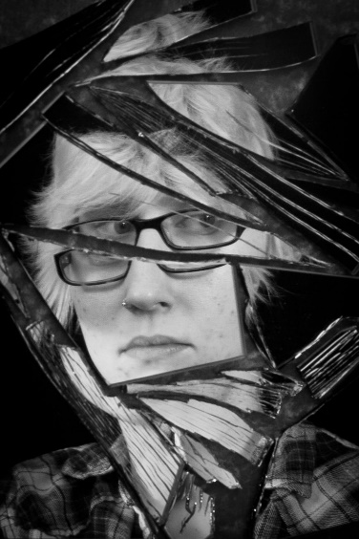
Dissociative Disorders
Dissociation
  Protection from extreme stress or shock
  Problems integrating realistic emotional memories
Types
  Dissociative amnesia – extreme memory loss due to previous psychological stress
  Dissociative Identity Disorder (DID) – VERY UNCOMMON manifestation of multiple personalities

Slide 58
Dissociative Amnesia
Individuals experience extreme memory loss caused by extensive psychological stress
  Protective means?
  Some define dissociative amnesia as something similar to repressed memories, which experts have great skepticism

Slide 59

Dissociative Amnesia
Hannah Upp was out running on Aug. 28th, 2008 before suddenly disappearing
After weeks of searching, she was found floating off Staten Island
She remembers running and being pulled from the harbor, but nothing in between

Slide 60
Dissociative Amnesia
Security camera footage and eyewitness testimony confirm that she went to an Apple store several times and even logged into her e-mail account
She stopped at several gyms, but did not revisit any of them
There was physical evidence that she spent a substantial amount of time in water

Slide 61
Dissociative Amnesia
Common for severe trauma, including disasters and abuse (Cloninger & Dokucu, 2008)
Why? Stress response can impair effective memory encoding, so there are no memories to recall (Allen, Console, & Lewis, 1999)

Slide 62
Dissociative Identity Disorder (DID)
Symptoms
  Same individual possesses two or more distinct personalities
  Each personality has unique memories/experiences, behaviors, and relationships
  Only one personality is dominant at a time
Etiology (Causes)
  Psychological Factors
    Extreme childhood abuse
  Social construction: Individuals choose to adopt these behaviors to make sense of their experiences (e.g., conflicting desires)

Slide 63
Dissociative Identity Disorder (DID)
Skepticism!!!
1980s: Only about 300 total cases had ever been diagnosed
  1000s have been diagnosed since
Social construction-Disorder is represented in films and TV like Sybil (1976) and Split (2016)
If it does exist, it is EXTREMELY rare and treatments are limited
  Sexual/physical abuse might be causes

Slide 64
Schizophrenia
Schizophrenia is a cluster of disorders marked by a range of symptoms

Slide 65
Schizophrenia
Highly disordered thought
  Split from reality
  Typically diagnosed in early adulthood
  High suicide risk

Slide 66
Symptoms of Schizophrenia
Positive Symptoms (symptoms patients possess)
  Hallucinations and delusions (psychosis)
    Typically auditory, but also visual and tactile
  Thought disorders
  Movement disorders (catatonic symptoms)
Negative Symptoms (missing behaviors/”symptoms”)
  Flat affect (showing little or no emotion)
  Negative emotions (social withdrawal/avoidance)
  Inability to engage in goal-directed behaviors
Cognitive Symptoms
  Lack of attentional control, memory difficulties
  Impaired decision making and impulse control

Slide 67
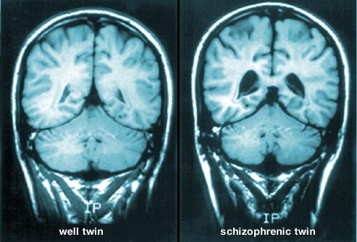
Etiology of Schizophrenia
Biological Factors
  Strong genetic predisposition – 48% of identical twins share disorder
  Structural brain abnormalities
    Enlarged ventricles
  Regulation of neurotransmitters
    Particularly elevated dopamine

Slide 68
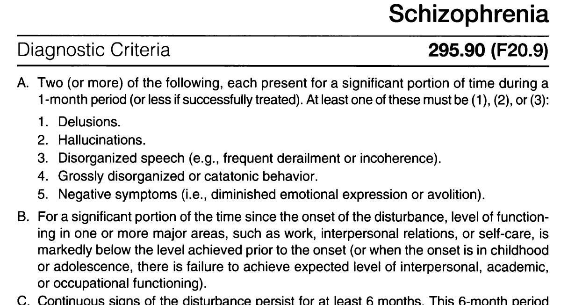
Schizophrenia – DSM-V

Slide 69
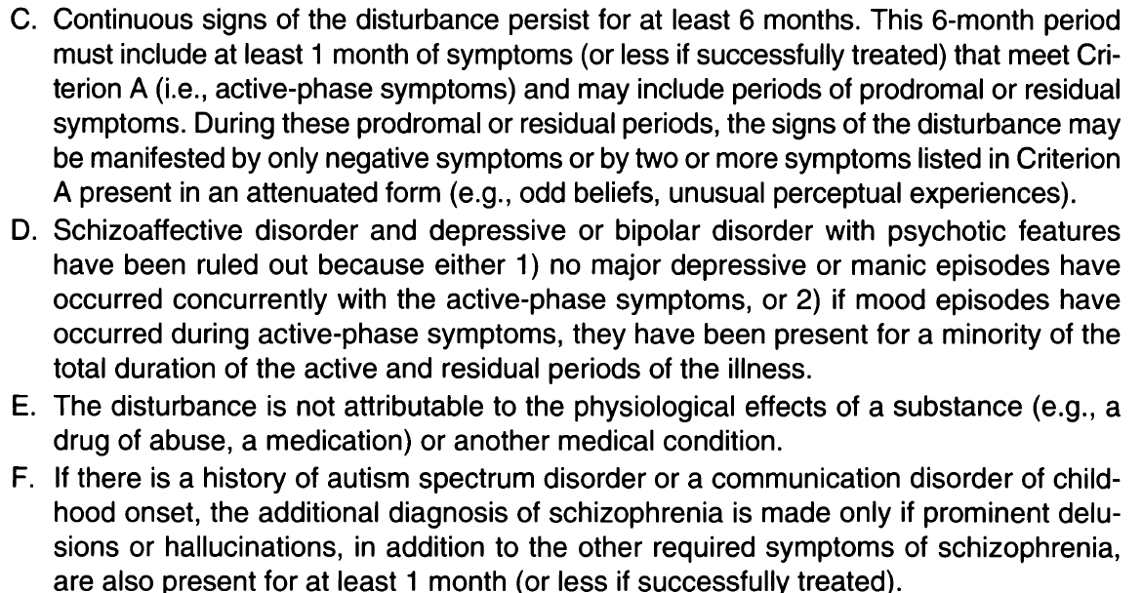
Schizophrenia – DSM-V

Slide 70
Personality Disorders
Personality disorders are characterized by patterns of thought or behavior that cause dysfunctional relationships or social life
Cluster A: Odd/Eccentric (Paranoid, Schizoid)
Cluster B: Dramatic/erratic (Antisocial, Borderline)
Cluster C: Anxious/Inhibited (Dependent, Obsessive-compulsive)

Slide 71
Personality Disorders
An enduring pattern of inner experience and behavior that deviates markedly from the expectations of an individual’s culture
Antisocial Personality Disorder
  Symptoms
    Guiltless law-breaking, violence, deceit
    Impulsive, irritable, reckless, irresponsibility
  Etiology
    Biological Factors: Genetic, NTs, Frontal Lobe differences, Men > Women

Slide 72
Personality Disorders
Borderline Personality Disorder
Symptoms
  Instability in interpersonal relationships and self-image
  Impulsive, insecure, unstable, extreme emotions (polarized thinking)
  Manipulative
  Self-harm/Suicidal
Etiology
  Genetic
  Childhood abuse/neglect
  Belief that others are hostile
  Women > Men
  Frontal Lobe/Amygdala deficits

Slide 73
Prejudice and Discrimination Accompany Mental Disorders
Mental illness is stigmatized
  Serial killers have a history of mental illness
  Mass shooters (i.e., Cho Seung-Hui (Virginia Tech, 2007); Adam Lanza (Sandy Hook, 2012); James Holmes (Colorado Moving Shooting, 2012) all have a history of mental illness

Slide 74
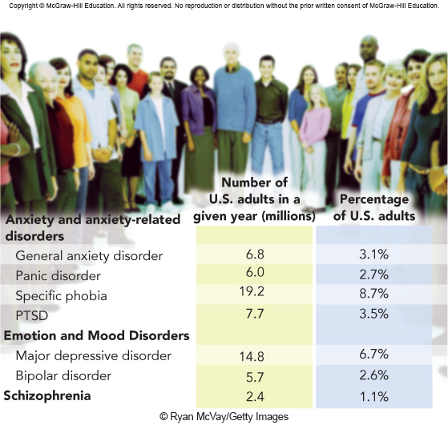
Prevalence of Common Mental Disorders

